Slide 1
Case Study: Airline ticket purchasing system
Name: Hong Sheng Lim
Student ID: s3700829

Slide 2
Case Study: Airline ticket purchasing system
Introduction
-An airline normally issues a flight booking itinerary indicating the destination of the flights, quantities and terms the customer had agreed on upon paying,
-A flight booking itinerary is used to control the flight destination, date and service agreed from the airline.
Purpose of System
- To allow airline staff and customer to manage the booking.

Slide 3
Case Study: Airline ticket purchasing system
(cont’d)
Description
-The flight booking itinerary is entered into the system by an airline staff.
-When placing an order, the following must be specified: customer details, flight number, quantity, add-ons and date of flight. The staff placing the order and the current date must be also recorded.
Entities present in the system
-itinerary
-customer
-flights
-staff

Slide 4
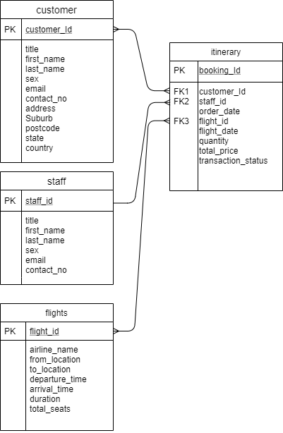
Airline ticket purchasing system - ERD

Slide 5
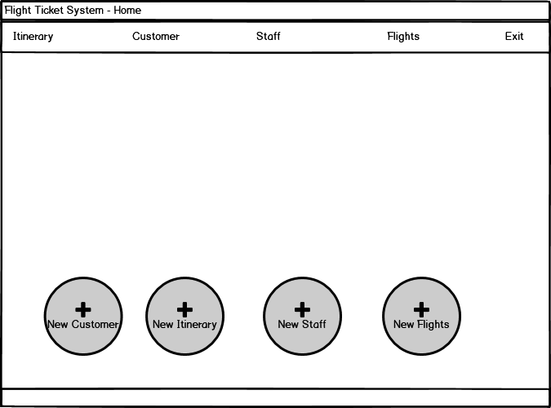
Airline ticket purchasing system - Mock-up
( Main Page)

Slide 6
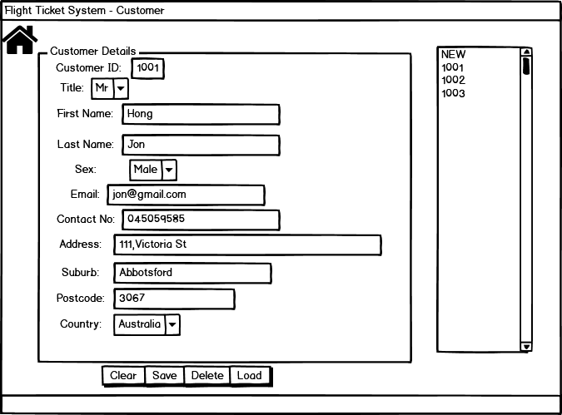
Airline ticket purchasing system - Mock-up
( Customer Page)

Slide 7
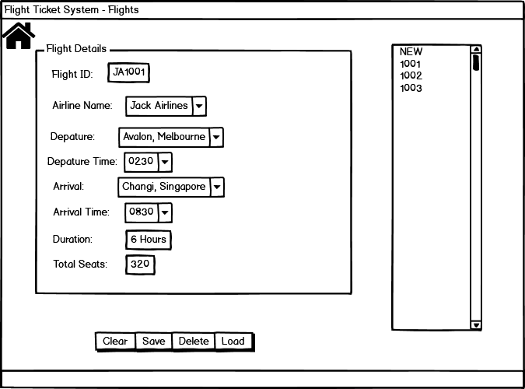
Airline ticket purchasing system - Mock-up
( Flights Page)

Slide 8
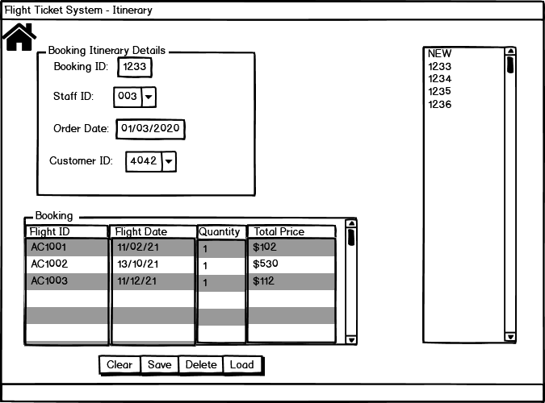
Airline ticket purchasing system - Mock-up
( Itinerary Page)

Slide 9
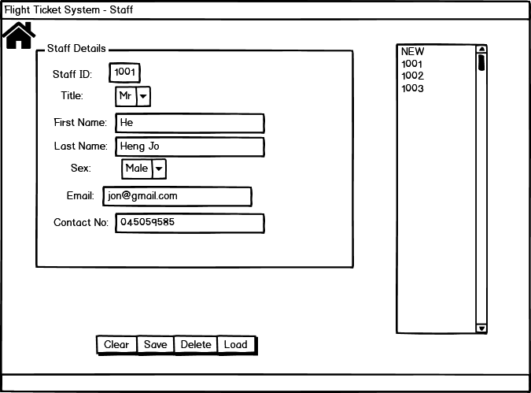
Airline ticket purchasing system - Mock-up
( Staff Page)

